Slide 1

Hello CS106B
CS 106B
Lecture 0
Jan 4, 2015

Slide 2
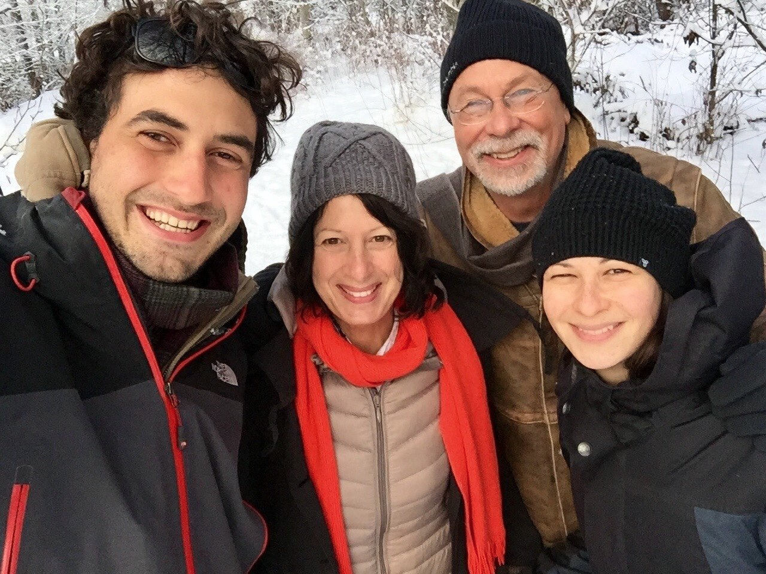
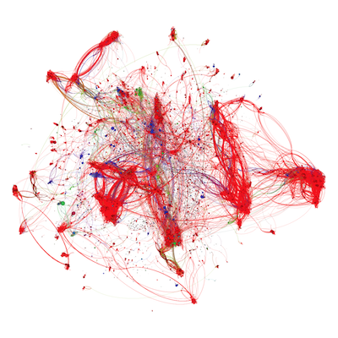
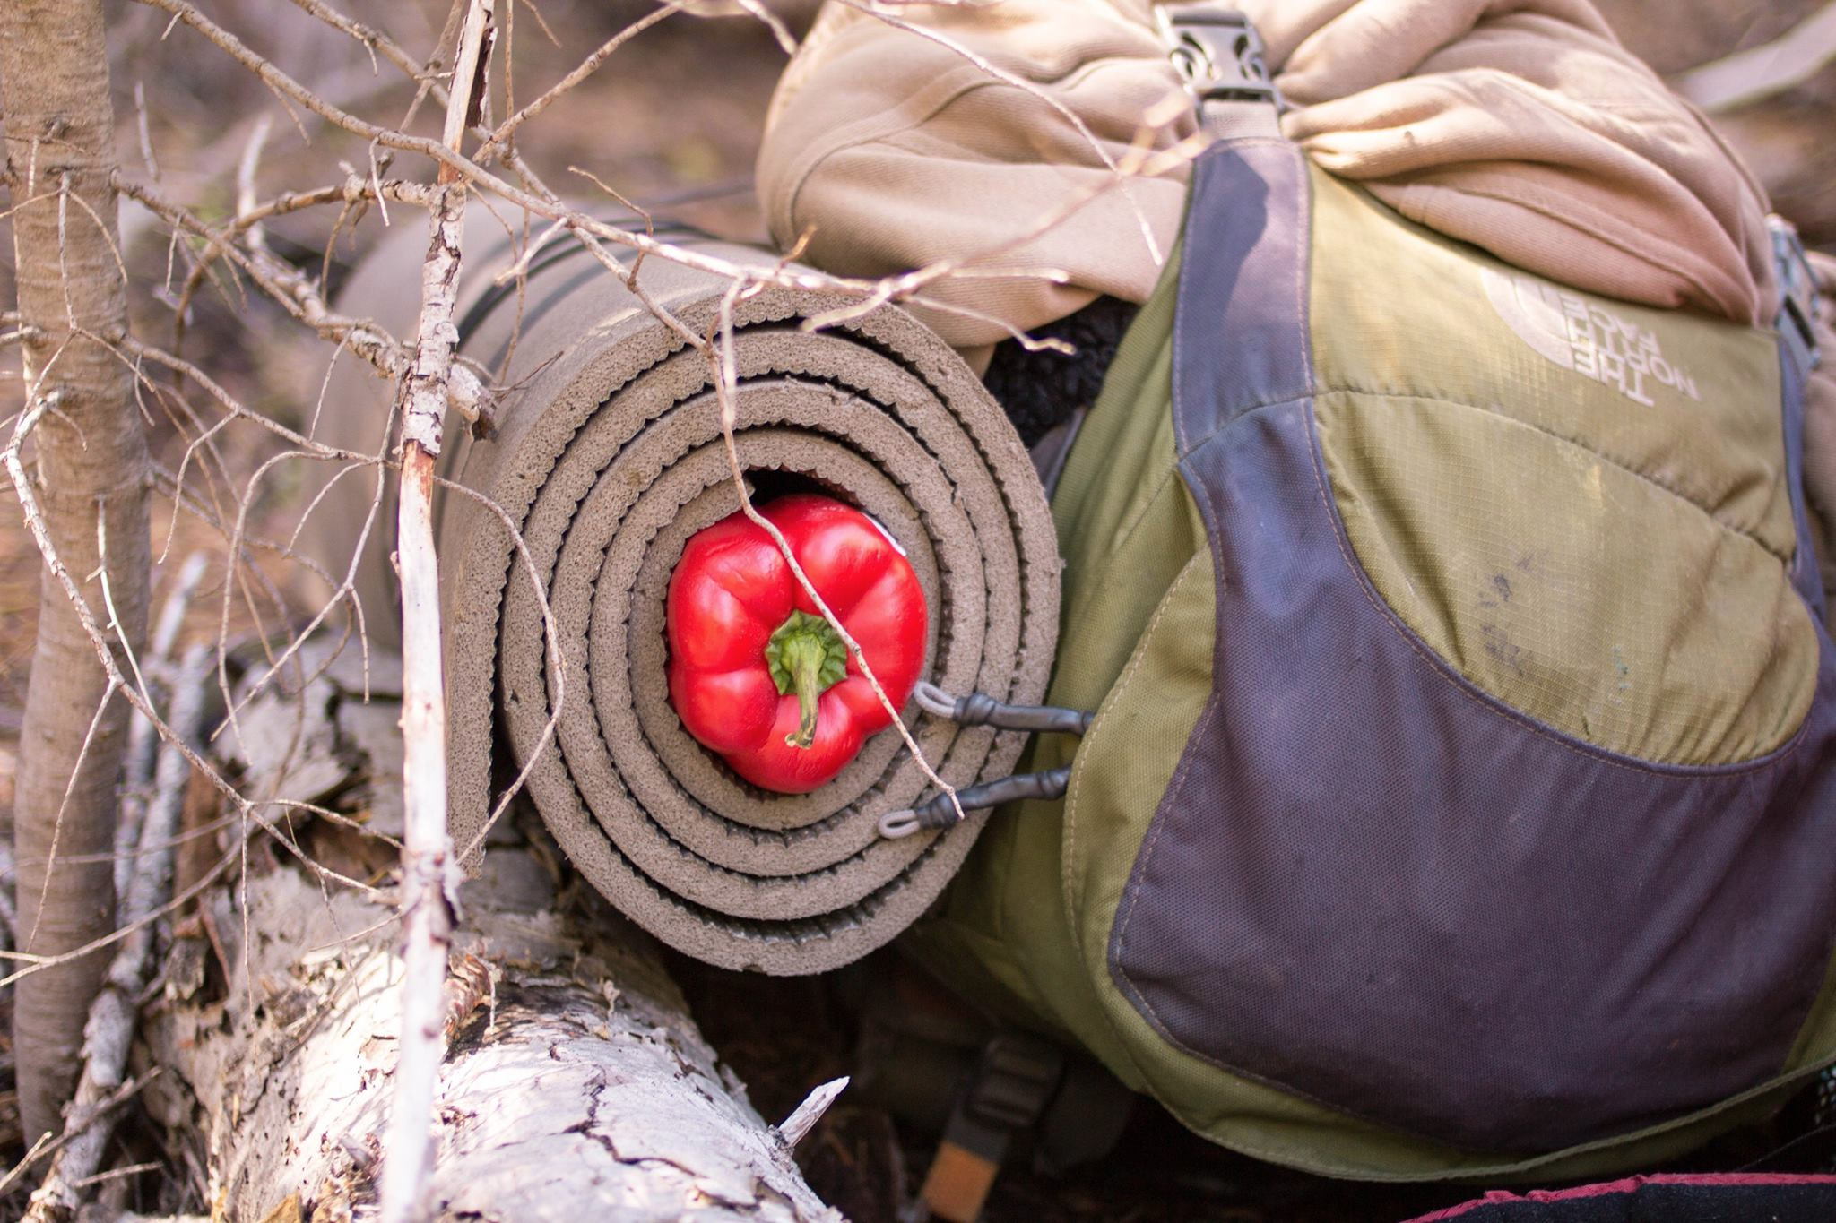
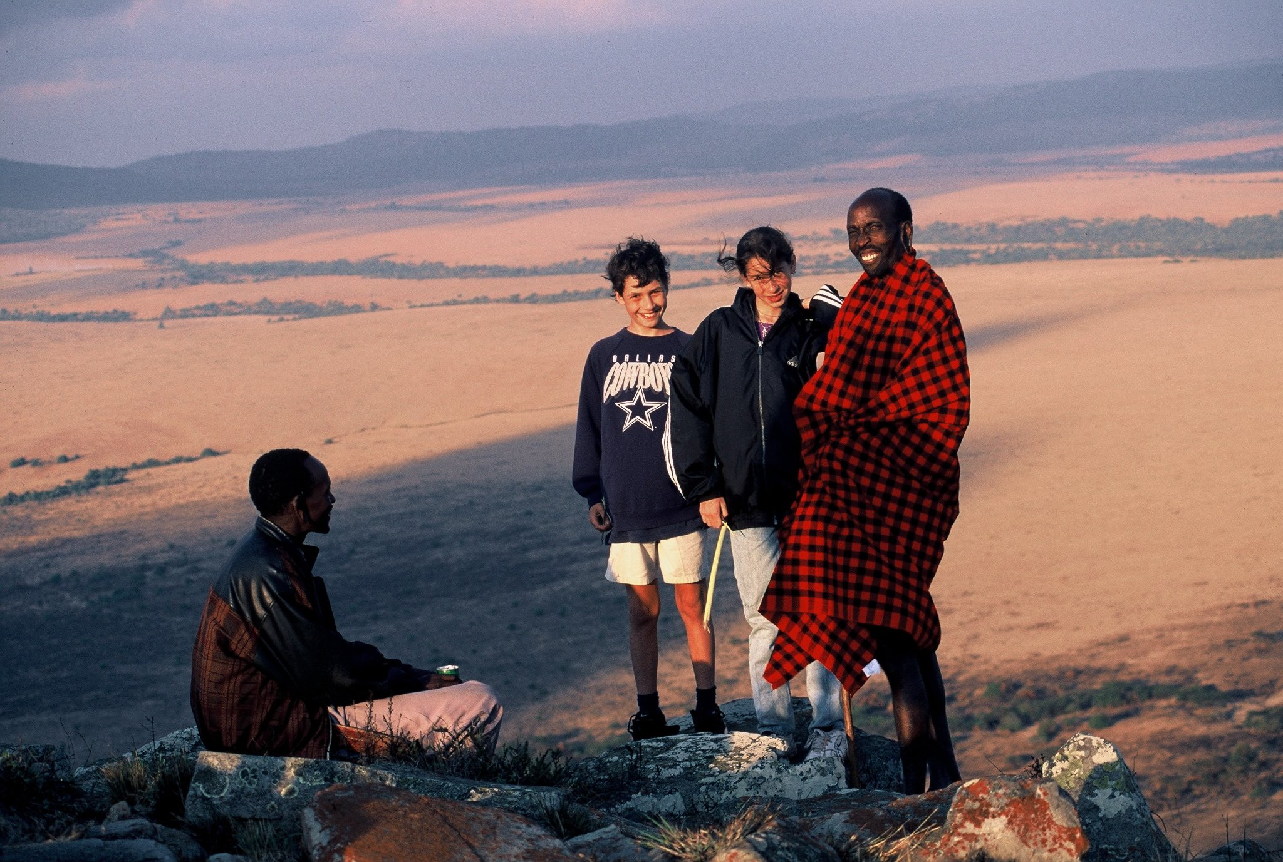
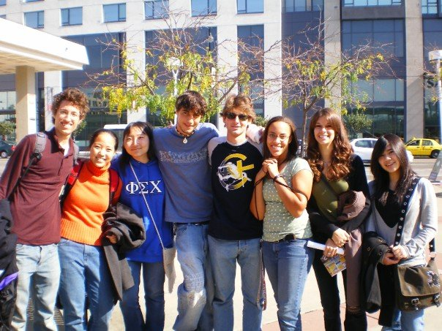
Hi, I’m Chris
Chris Piech (piech@cs.stanford.edu)

Slide 3
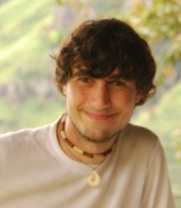
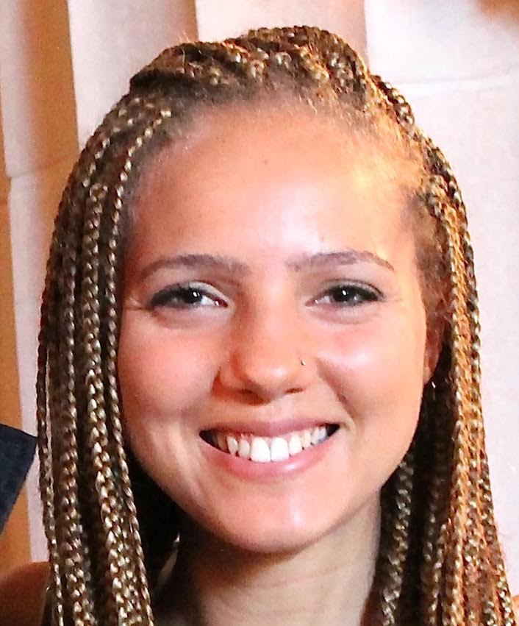
Course Staff
Instructor: Chris Piech
Head TA: Megan Faulk

Slide 4
Who are You?

Slide 5
Who are You?
African Studies
Applied Physics
Bioengineering
Biology
Business Administration
Chemical Engineering
Chemistry
Classics
Civil and Environmental Engineering
Computational and Mathematical Engineering
Computer Science
Creative Writing
East Asian Studies
Economics
Education
Electrical Engineering
Energy Resource Engineering
English
Financial Mathematics
Film and Media Studies
French
History
International Relations
Japanese
Law
Materials Science and Engineering
Mathematical and Computational Sciences
Mathematics
Mechanical Engineering
Medicine
Management Science and Engineering
Modern Language
Music
Neuroscience
Physics
Political Science
Psychology
Science, Technology, and Society
Statistics
Symbolic Systems
Undeclared!

Slide 6

Logistics
Course Overview
First Program
Excited?

Slide 7
Logistics
Course Overview
First Program
Excited?

Slide 8
Essential Information
cs106b.stanford.edu

Slide 9
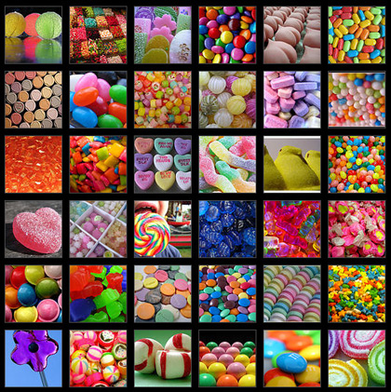
Candy Policy

Slide 10
Assignments in CS106B
Due at 5:00P.M.
Three free “late days”
Extensions approved by Megan or Chris.
Graded by your section leader
Interactive, one-on-one grading session.
Graded on Style and Functionality.

Slide 11


Grading Scale
Functionality and style grades for the assignments use the following scale:
A submission so good it “makes you weep.”
Exceeds requirements.
Satisfies all requirements of the assignment.
Meets most requirements, but with some problems.
Has more serious problems.
Is even worse than that.
Better than nothing.

Slide 12
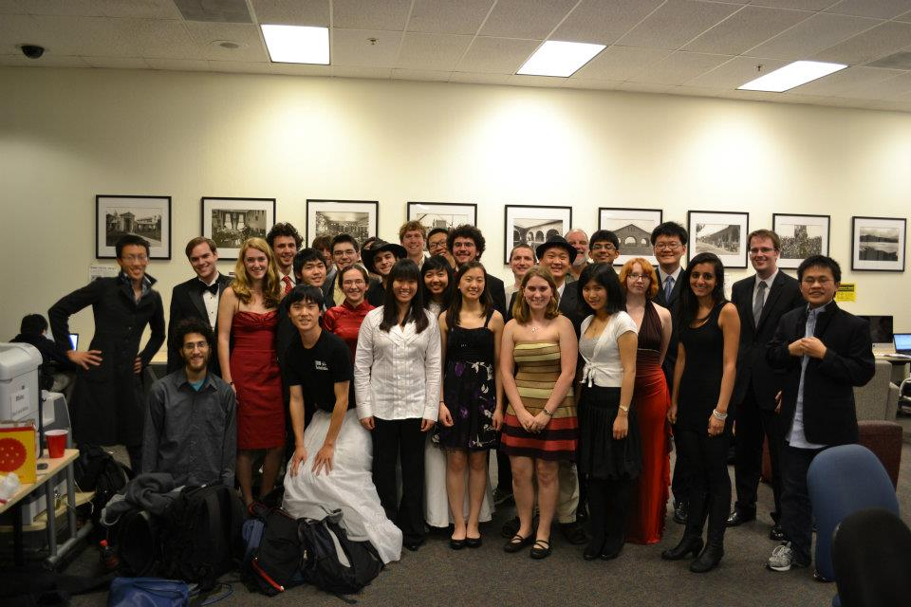
Sections
Weekly 50-min section led by awesome section leaders (the backbone of the class!)
Signups begin on Thursday at 5:00pm and close Sunday at 5:00pm

Slide 13
Staff Contact
Post to Piazza
Contact your Section Leader
Go to the LaIR or Office Hours
Email cs106b-win1516-staff@lists.stanford.edu
Call us.

Slide 14

Attendance

Slide 15
Grade Breakdown
Final: Monday, March 14th

Slide 16
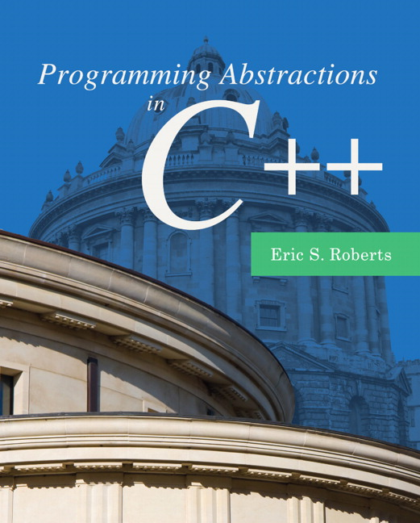
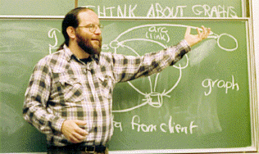
Textbook
Programming Abstractions in C++, by Eric Roberts
written here at Stanford
tailored to this course
a valuable reference
usable on open-book exams

Slide 17
Honor Code
Rule 1:
You must not share actual program code with other students.
Rule 2:
You must not look at solutions posted on the web or from other years.
Rule 3:
If you realize that you have made a mistake, you may retract your submission to any assignment at any time, no questions asked.

Slide 18
How Many Units?
int numUnits(bool isGrad, bool wantsFewerUnits) {
if (!isGrad) return 5;
if (!wantsFewerUnits) return 5;
if (reallyBusy()) {
return 3;
} else {
return 4;
}
}

Slide 19
How Many Units?
int numUnits(bool isGrad, bool wantsFewerUnits) {
if (!isGrad) return 5;
if (!wantsFewerUnits) return 5;
if (reallyBusy()) {
return 3;
} else {
return 4;
}
}

Slide 20
How Many Units?
int numUnits(bool isGrad, bool wantsFewerUnits) {
if (!isGrad) return 5;
if (!wantsFewerUnits) return 5;
if (reallyBusy()) {
return 3;
} else {
return 4;
}
}

Slide 21
How Many Units?
int numUnits(bool isGrad, bool wantsFewerUnits) {
if (!isGrad) return 5;
if (!wantsFewerUnits) return 5;
if (reallyBusy()) {
return 3;
} else {
return 4;
}
}

Slide 22
How Many Units?
int numUnits(bool isGrad, bool wantsFewerUnits) {
if (!isGrad) return 5;
if (!wantsFewerUnits) return 5;
if (reallyBusy()) {
return 3;
} else {
return 4;
}
}

Slide 23
Getting Help
LaIR Hours!
Sunday – Thursday, 6PM – Midnight
Starts next week.
Chris’ Office Hours in Gates 193
Monday 1:30pm – 2:30pm
Wednesday 2:30PM – 4:00PM
Megan's Office Hours in Gates B02
Tuesday 9am – 10am
Thursday 9am – 10:30am

Slide 24
Logistics
Course Overview
First Program
Excited?

Slide 25
Logistics
Course Overview
First Program
Excited?

Slide 26
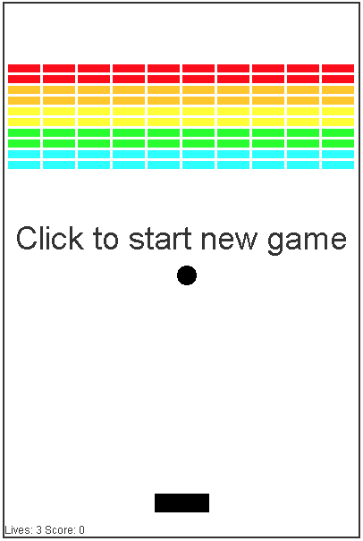
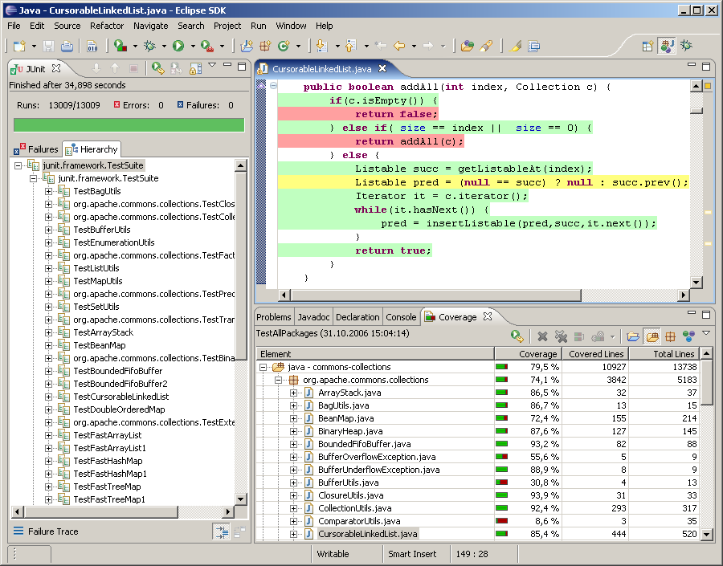
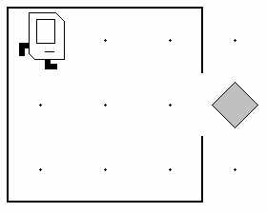
What Was CS106A?
CS 106A: Programming Methodology
a first course in programming, software development

Slide 27
What's next in Computer Science?

Slide 29
[suspense]

Slide 30
CS106B!

Slide 31
Goals for the Course
Learn how to model and solve complex problems with computers.
To that end:
Explore common abstractions for representing problems.
Harness recursion and understand how to think about problems recursively.
Learn and analyze different approaches for solving problems.

Slide 32
Goals for the Course
Learn how to model and solve complex problems with computers.
To that end:
Explore common abstractions for representing problems.
Harness recursion and understand how to think about problems recursively.
Learn and analyze different approaches for solving problems.

Slide 33
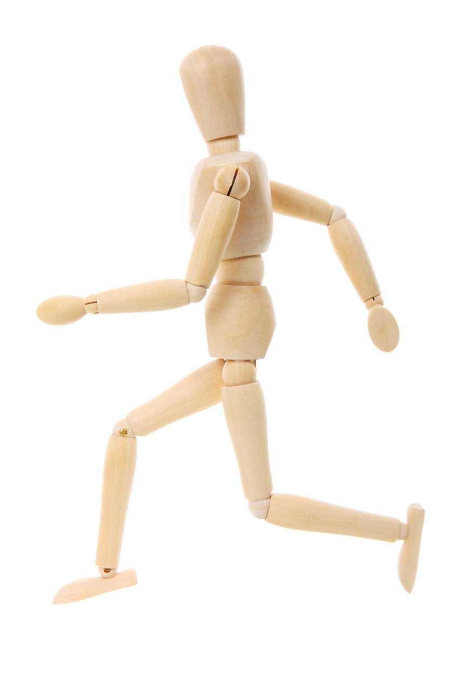
http://www.publicdomainpictures.net/pictures/10000/velka/1-1265899974oKJ9.jpg

Slide 34
http://www.publicdomainpictures.net/pictures/10000/velka/1-1265899974oKJ9.jpg

Slide 35
Sentence
Subject
Verb Phrase
Object
Noun
Adverb
Verb
Possessive
Noun
CS106B
totally
rocks
my
socks

Slide 40
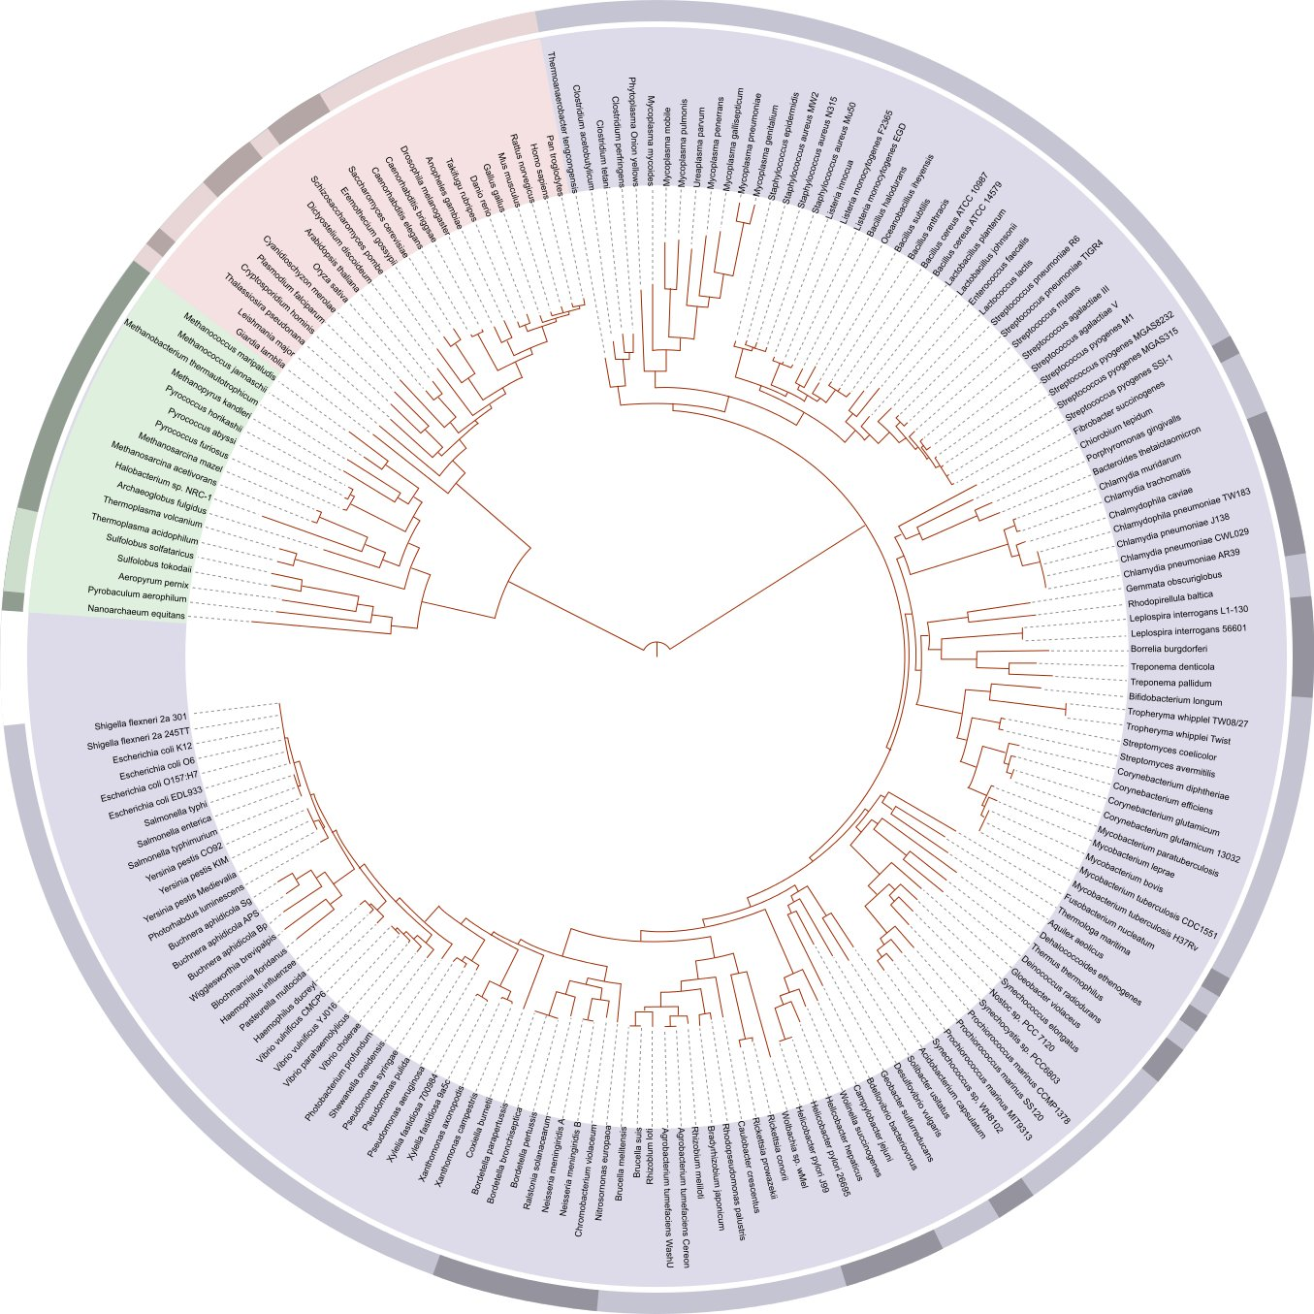
Hey, that's us!
http://en.wikipedia.org/wiki/File:Tree_of_life_SVG.svg

Slide 42
Building a vocabulary of abstractions
makes it possible to represent and solve a wider class of problems.

Slide 43
Goals for the Course
Learn how to model and solve complex problems with computers.
To that end:
Explore common abstractions for representing problems.
Harness recursion and understand how to think about problems recursively.
Learn and analyze different approaches for solving problems.

Slide 44
Goals for the Course
Learn how to model and solve complex problems with computers.
To that end:
Explore common abstractions for representing problems.
Harness recursion and understand how to think about problems recursively.
Learn and analyze different approaches for solving problems.

Slide 45

http://www.marketoracle.co.uk/images/2010/Oct/fractal-tree2.jpg

Slide 46
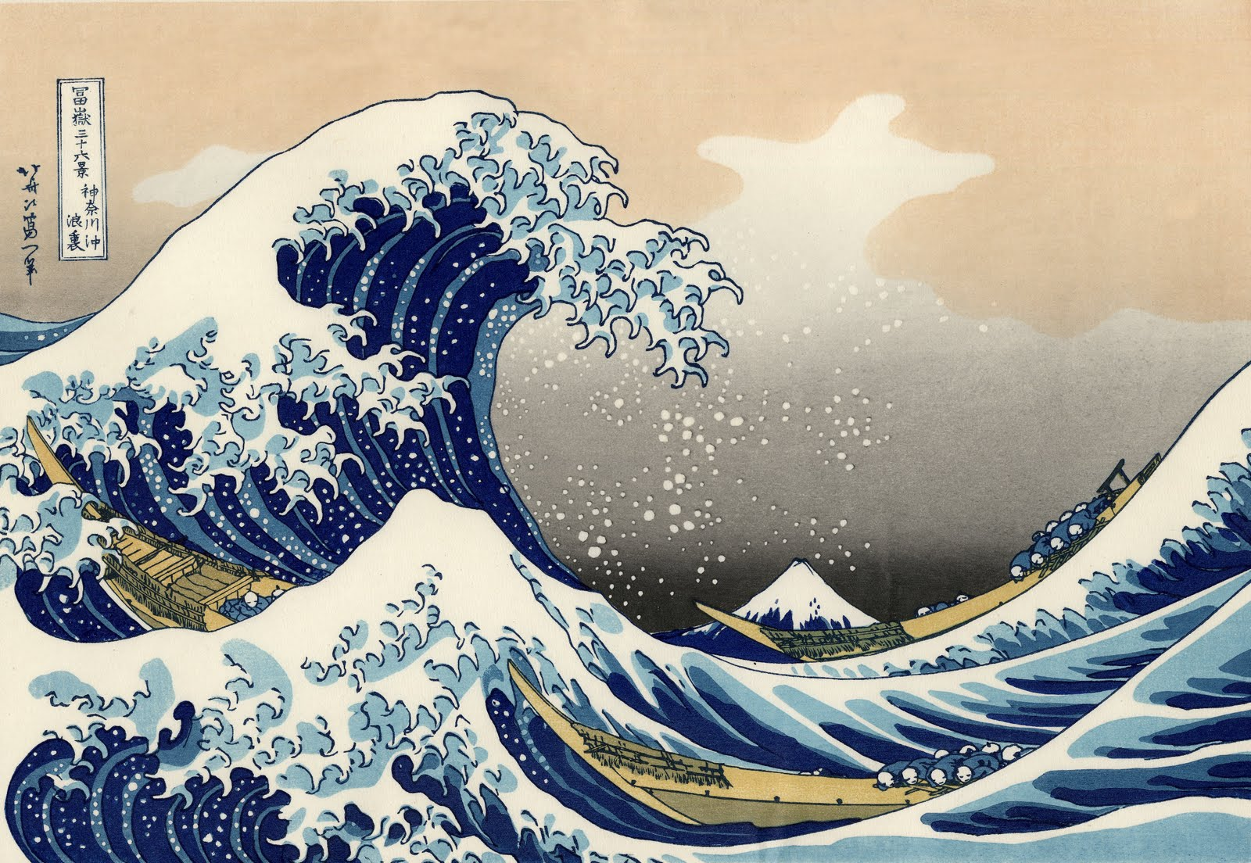
http://1.bp.blogspot.com/-Hwf-U9hRwEI/TX480ONoo6I/AAAAAAAAAcM/fyBi0I5HsUI/s1600/the_great_wave_off_kanagawa.jpg

Slide 47


Slide 48

.
.
.
.
.
.
.
.
.
.
.
.
.
.
.
.
.
.
.
.
.
.
.
.
.

Slide 49
.
.
.
.
.
.
.
.
.
.
.
.
.
.
.
.
.
.
.
.
.
.
.
.
.

Slide 50
Width 1
.

Slide 51
.
.
.
.
.
.
.

Slide 52
.
.
.
.
.
.
.

Slide 53
.
.
.
.
.
.
.

Slide 54
.
.
.
.
.
.
.

Slide 55
.
.
.
.
.
.
.

Slide 56
.
.
.
.
.
.
.

Slide 57
.
.
.
.
.
.
.

Slide 58
Finding the Midpoint
If the width is 1, Karel is standing on the midpoint.
Otherwise:
Take two safe steps forward.
Find the midpoint of the rest of the world.
Take one step backward.

Slide 59
A Surprisingly Short Solution

Slide 60
A recursive solution is a solution that is defined in terms of itself.

Slide 61
Thinking recursively allows you
to solve an enormous class of
problems cleanly and concisely.

Slide 62
Goals for the Course
Learn how to model and solve complex problems with computers.
To that end:
Explore common abstractions for representing problems.
Harness recursion and understand how to think about problems recursively.
Learn and analyze different approaches for solving problems.

Slide 63
Goals for the Course
Learn how to model and solve complex problems with computers.
To that end:
Explore common abstractions for representing problems.
Harness recursion and understand how to think about problems recursively.
Learn and analyze different approaches for solving problems.

Slide 64
10
17
7
14
13
7
7
7
3
9
13
6
5
18
4
15
10
7
2
4
5
8
7
20
17
13
9
14
7
14
11
9
12

Slide 65
10
17
7
14
from
13
7
7
7
3
9
13
6
5
18
4
15
10
7
2
4
5
8
7
20
17
13
9
14
7
14
11
9
12
to

Slide 66
10
17
7
14
from
13
7
7
7
3
9
13
6
5
18
4
15
10
7
2
4
5
8
7
20
17
13
9
14
7
14
11
9
12
to

Slide 67
10
17
7
14
from
13
7
7
7
3
9
13
6
5
18
4
15
10
7
2
4
5
8
7
20
17
13
9
14
7
14
11
9
12
to
Travel Time: 13 + 15 + 17 + 14 + 11 + 9 + 12 = 91

Slide 68
10
17
7
14
from
13
7
7
7
3
9
13
6
5
18
4
15
10
7
2
4
5
8
7
20
17
13
9
14
7
14
11
9
12
to

Slide 69
10
17
7
14
from
13
7
7
7
3
9
13
6
5
18
4
15
10
7
2
4
5
8
7
20
17
13
9
14
7
14
11
9
12
to
Travel Time: 10 + 17 + 7 + 14 + 13 + 4 + 7 = 72

Slide 70
10
17
7
14
from
13
7
7
7
3
9
13
6
5
18
4
15
10
7
2
4
5
8
7
20
17
13
9
14
7
14
11
9
12
to

Slide 71
10
17
7
14
from
13
7
7
7
3
9
13
6
5
18
4
15
10
7
2
4
5
8
7
20
17
13
9
14
7
14
11
9
12
to

Slide 72
10
17
7
14
from
13
7
7
7
3
9
13
6
5
18
4
15
10
7
2
4
5
8
7
20
17
13
9
14
7
14
11
9
12
to

Slide 73
10
17
7
14
from
13
7
7
7
3
9
13
6
5
18
4
15
10
7
2
4
5
8
7
20
17
13
9
14
7
14
11
9
12
to

Slide 74
10
17
7
14
from
13
In an n × n grid, there are at least 4^{n} / n possible paths from one corner to another.
If n = 154, this is approximately equal to the number of atoms in the universe.
7
7
7
3
9
13
6
5
18
4
15
10
7
2
4
5
8
7
20
17
13
9
14
7
14
11
9
12
to

Slide 75
10
17
7
14
from
13
In an n × n grid, there are at least 4^{n} / n possible paths from one corner to another.
If n = 50, it would take the lifetime of the universe to list off all possible paths.
7
7
7
3
9
13
6
5
18
4
15
10
7
2
4
5
8
7
20
17
13
9
14
7
14
11
9
12
to

Slide 76

10
17
7
14
from
13
In an n × n grid, there are at least 4^{n} / n possible paths from one corner to another.
If n = 50, it would take the lifetime of the universe to list off all possible paths.
7
7
7
3
9
13
6
5
18
4
15
10
7
2
4
5
8
7
20
17
13
9
14
7
14
11
9
12
to

Slide 77
10
17
7
14
from
13
7
7
7
3
9
13
6
5
18
4
15
10
7
2
4
5
8
7
20
17
13
9
14
7
14
11
9
12
to

Slide 78
10
17
7
14
from
0
13
7
7
7
3
9
13
6
5
18
4
15
10
7
2
4
5
8
7
20
17
13
9
14
7
14
11
9
12
to

Slide 79
10
17
7
14
from
0
13
7
7
7
3
9
13
6
5
18
4
15
10
7
2
4
5
8
7
20
17
13
9
14
7
14
11
9
12
to

Slide 80
10
17
7
14
from
0
10?
13
7
7
7
3
9
13
6
5
18
4
13?
15
10
7
2
4
5
8
7
20
17
13
9
14
7
14
11
9
12
to

Slide 81
10
10?
17
7
14
from
0
10?
13
7
7
7
3
9
13
6
5
18
4
13?
15
10
7
2
4
5
8
7
20
17
13
9
14
7
14
11
9
12
to

Slide 82
10
17
7
14
from
0
10
13
7
7
7
3
9
13
6
5
18
4
13?
15
10
7
2
4
5
8
7
20
17
13
9
14
7
14
11
9
12
to

Slide 83
10
17
7
14
from
0
10
27?
13
7
7
7
3
9
13
6
5
18
4
13?
17?
15
10
7
2
4
5
8
7
20
17
13
9
14
7
14
11
9
12
to

Slide 84
10
17
7
14
from
0
10
27?
13
7
7
7
3
9
13
13?
6
5
18
4
13?
17?
15
10
7
2
4
5
8
7
20
17
13
9
14
7
14
11
9
12
to

Slide 85
10
17
7
14
from
0
10
27?
13
7
7
7
3
9
13
6
5
18
4
13
17?
15
10
7
2
4
5
8
7
20
17
13
9
14
7
14
11
9
12
to

Slide 86
10
17
7
14
from
0
10
27?
13
7
7
7
3
9
13
6
5
18
4
13
17?
15
10
7
2
4
5
8
7
20
28?
17
13
9
14
7
14
11
9
12
to

Slide 87
10
17
7
14
from
0
10
27?
13
7
7
7
3
9
13
6
17?
5
18
4
13
17?
15
10
7
2
4
5
8
7
20
28?
17
13
9
14
7
14
11
9
12
to

Slide 88
10
17
7
14
from
0
10
27?
13
7
7
7
3
9
13
6
5
18
4
13
17
15
10
7
2
4
5
8
7
20
28?
17
13
9
14
7
14
11
9
12
to

Slide 89
10
17
7
14
from
0
10
27?
13
7
7
7
3
9
13
6
5
18
4
13
17
22?
15
10
7
2
4
5
8
7
20
28?
27?
17
13
9
14
7
14
11
9
12
to

Slide 90
10
17
7
14
from
0
10
27?
13
7
7
7
3
9
13
6
5
18
4
13
17
22
15
10
7
2
4
5
8
7
20
28?
27?
17
13
9
14
7
14
11
9
12
to

Slide 91
10
17
7
14
from
0
10
25?
13
7
7
7
3
9
13
6
5
18
4
13
17
22
40?
15
10
7
2
4
5
8
7
20
28?
27?
29?
17
13
9
14
7
14
11
9
12
to

Slide 92
10
17
7
14
from
0
10
25
13
7
7
7
3
9
13
6
5
18
4
13
17
22
40?
15
10
7
2
4
5
8
7
20
28?
27?
29?
17
13
9
14
7
14
11
9
12
to

Slide 93
10
17
7
14
from
0
10
25
32?
13
7
7
7
3
9
13
6
5
18
4
13
17
22
40?
15
10
7
2
4
5
8
7
20
28?
27?
29?
17
13
9
14
7
14
11
9
12
to

Slide 94
10
17
7
14
from
0
10
25
32?
13
7
7
7
3
9
13
6
5
18
4
13
17
22
40?
15
10
7
2
4
5
8
7
20
28?
27
29?
17
13
9
14
7
14
11
9
12
to

Slide 95
10
17
7
14
from
0
10
25
32?
13
7
7
7
3
9
13
6
5
18
4
13
17
22
40?
15
10
7
2
4
5
8
7
20
28?
27
29?
17
13
9
14
7
14
11
9
12
40?
to

Slide 96
10
17
7
14
from
0
10
25
32?
13
7
7
7
3
9
13
6
5
18
4
13
17
22
40?
15
10
7
2
4
5
8
7
20
28
27
29?
17
13
9
14
7
14
11
9
12
40?
to

Slide 97
10
17
7
14
from
0
10
25
32?
13
7
7
7
3
9
13
6
5
18
4
13
17
22
40?
15
10
7
2
4
5
8
7
20
28
27
29?
17
13
9
14
7
14
11
9
12
45?
40?
to

Slide 98
10
17
7
14
from
0
10
25
32?
13
7
7
7
3
9
13
6
5
18
4
13
17
22
40?
15
10
7
2
4
5
8
7
20
28
27
29
17
13
9
14
7
14
11
9
12
45?
40?
to

Slide 99
10
17
7
14
from
0
10
25
32?
13
7
7
7
3
9
13
6
5
18
4
13
17
22
40?
15
10
7
2
4
5
8
7
20
28
27
29
36?
17
13
9
14
7
14
11
9
12
45?
40?
38?
to

Slide 100
10
17
7
14
from
0
10
25
32
13
7
7
7
3
9
13
6
5
18
4
13
17
22
40?
15
10
7
2
4
5
8
7
20
28
27
29
36?
17
13
9
14
7
14
11
9
12
45?
40?
38?
to

Slide 101
10
17
7
14
from
0
10
25
32
46?
13
7
7
7
3
9
13
6
5
18
4
13
17
22
40?
15
10
7
2
4
5
8
7
20
28
27
29
36?
17
13
9
14
7
14
11
9
12
45?
40?
38?
to

Slide 102
10
17
7
14
from
0
10
25
32
46?
13
7
7
7
3
9
13
6
5
18
4
13
17
22
40?
15
10
7
2
4
5
8
7
20
28
27
29
36
17
13
9
14
7
14
11
9
12
45?
40?
38?
to

Slide 103
10
17
7
14
from
0
10
25
32
46?
13
7
7
7
3
9
13
6
5
18
4
13
17
22
38?
15
10
7
2
4
5
8
7
20
28
27
29
36
56?
17
13
9
14
7
14
11
9
12
45?
40?
38?
50?
to

Slide 104
10
17
7
14
from
0
10
25
32
46?
13
7
7
7
3
9
13
6
5
18
4
13
17
22
38?
15
10
7
2
4
5
8
7
20
28
27
29
36
56?
17
13
9
14
7
14
11
9
12
45?
40?
38
50?
to

Slide 105
10
17
7
14
from
0
10
25
32
46?
13
7
7
7
3
9
13
6
5
18
4
13
17
22
38?
15
10
7
2
4
5
8
7
20
28
27
29
36
56?
17
13
9
14
7
14
11
9
12
45?
40?
38
47?
to

Slide 106
10
17
7
14
from
0
10
25
32
46?
13
7
7
7
3
9
13
6
5
18
4
13
17
22
38
15
10
7
2
4
5
8
7
20
28
27
29
36
56?
17
13
9
14
7
14
11
9
12
45?
40?
38
47?
to

Slide 107
10
17
7
14
from
0
10
25
32
46?
13
7
7
7
3
9
13
6
5
18
4
13
17
22
38
42?
15
10
7
2
4
5
8
7
20
28
27
29
36
56?
17
13
9
14
7
14
11
9
12
45?
40?
38
47?
to

Slide 108
10
17
7
14
from
0
10
25
32
46?
13
7
7
7
3
9
13
6
5
18
4
13
17
22
38
42?
15
10
7
2
4
5
8
7
20
28
27
29
36
56?
17
13
9
14
7
14
11
9
12
45?
40
38
47?
to

Slide 109
10
17
7
14
from
0
10
25
32
46?
13
7
7
7
3
9
13
6
5
18
4
13
17
22
38
42
15
10
7
2
4
5
8
7
20
28
27
29
36
56?
17
13
9
14
7
14
11
9
12
45?
40
38
47?
to

Slide 110
10
17
7
14
from
0
10
25
32
46?
13
7
7
7
3
9
13
6
5
18
4
13
17
22
38
42
15
10
7
2
4
5
8
7
20
28
27
29
36
46?
17
13
9
14
7
14
11
9
12
45?
40
38
47?
to

Slide 111
10
17
7
14
from
0
10
25
32
46?
13
7
7
7
3
9
13
6
5
18
4
13
17
22
38
42
15
10
7
2
4
5
8
7
20
28
27
29
36
46?
17
13
9
14
7
14
11
9
12
45
40
38
47?
to

Slide 112
10
17
7
14
from
0
10
25
32
46?
13
7
7
7
3
9
13
6
5
18
4
13
17
22
38
42
15
10
7
2
4
5
8
7
20
28
27
29
36
46
17
13
9
14
7
14
11
9
12
45
40
38
47?
to

Slide 113
10
17
7
14
from
0
10
25
32
46?
13
7
7
7
3
9
13
6
5
18
4
13
17
22
38
42
15
10
7
2
4
5
8
7
20
28
27
29
36
46
17
13
9
14
7
14
11
9
12
45
40
38
47?
53?
to

Slide 114
10
17
7
14
from
0
10
25
32
46
13
7
7
7
3
9
13
6
5
18
4
13
17
22
38
42
15
10
7
2
4
5
8
7
20
28
27
29
36
46
17
13
9
14
7
14
11
9
12
45
40
38
47?
53?
to

Slide 115
10
17
7
14
from
0
10
25
32
46
13
7
7
7
3
9
13
6
5
18
4
13
17
22
38
42
15
10
7
2
4
5
8
7
20
28
27
29
36
46
17
13
9
14
7
14
11
9
12
45
40
38
47
53?
to

Slide 116
10
17
7
14
from
0
10
25
32
46
13
7
7
7
3
9
13
6
5
18
4
13
17
22
38
42
15
10
7
2
4
5
8
7
20
28
27
29
36
46
17
13
9
14
7
14
11
9
12
45
40
38
47
53
to

Slide 117
10
17
7
14
from
0
10
25
32
46
13
7
7
7
3
9
13
6
5
18
4
13
17
22
38
42
15
10
7
2
4
5
8
7
20
28
27
29
36
46
17
13
9
14
7
14
11
9
12
45
40
38
47
53
to

Slide 118
10
17
7
14
from
0
10
25
32
46
13
7
7
7
3
9
13
6
5
18
4
13
This approach is called Dijkstra's Algorithm.
Google Maps uses a slightly modified version of this algorithm.
For an n × n grid, it requires (roughly speaking) n log n operations to find the shortest path.
17
22
38
42
15
10
7
2
4
5
8
7
20
28
27
29
36
46
17
13
9
14
7
14
11
9
12
45
40
38
47
53
to

Slide 119
10
17
7
14
from
0
10
25
32
46
13
7
7
7
3
9
13
6
5
18
4
13
This approach is called Dijkstra's Algorithm.
Google Maps uses a slightly modified version of this algorithm.
For an n × n grid, it requires (roughly speaking) n log n operations to find the shortest path.
17
22
38
42
15
10
7
2
4
5
8
7
20
28
27
29
36
46
17
13
9
14
7
14
11
9
12
45
40
38
47
53
to

Slide 120
10
17
7
14
from
0
10
25
32
46
13
7
7
7
3
9
13
6
5
18
4
13
This approach is called Dijkstra's Algorithm.
Google Maps uses a slightly modified version of this algorithm.
For an n × n grid, it requires some multiple of n log n operations to find the shortest path.
17
22
38
42
15
10
7
2
4
5
8
7
20
28
27
29
36
46
17
13
9
14
7
14
11
9
12
45
40
38
47
53
to

Slide 121
Goals for the Course
Learn how to model and solve complex problems with computers.
To that end:
Explore common abstractions for representing problems.
Harness recursion and understand how to think about problems recursively.
Learn and analyze different approaches for solving problems.

Slide 122
Course Syllabus

Slide 123
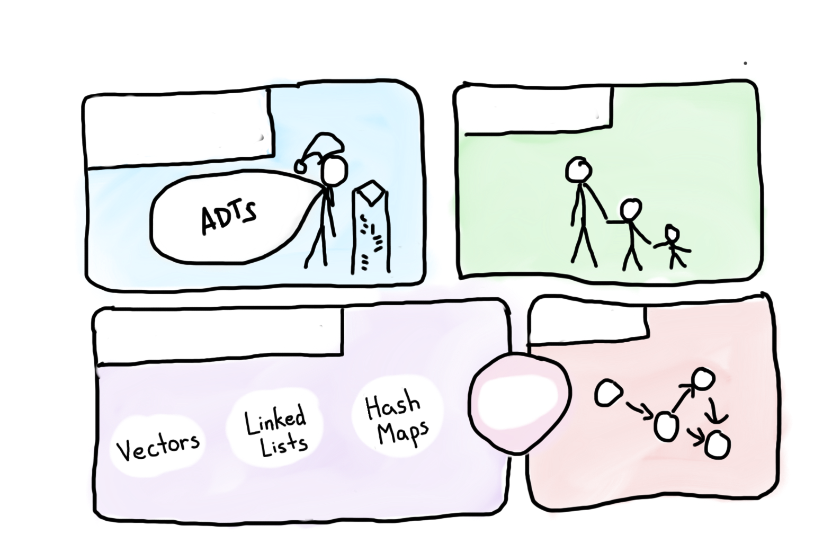
Course Syllabus
Intro to Abstractions
Recursion
Graphs
Under the Hood
Trees

Slide 124

Course Syllabus
Intro to Abstractions
Recursion
Graphs
Under the Hood
Trees
You are here

Slide 125
Is CS106B the Right Class?
CS 106A: Programming Methodology (ENGR 70A)
Introduction to the engineering of computer applications emphasizing modern software engineering principles: object-oriented design, decomposition, encapsulation, abstraction, and testing. Uses the Java programming language. Emphasis is on good programming style and the built-in facilities of the Java language. No prior programming experience required.
Terms: Aut, Win, Spr, Sum | Units: 3-5 | UG Reqs: GER:DBEngrAppSci | Grading: Letter or Credit/No Credit
Instructors: Burr, B. (PI); Cain, G. (PI); Cooper, S. (PI); Jimenez, O. (PI); Sahami, M. (PI)
CS 106X: Programming Abstractions (Accelerated) (ENGR 70X)
Intensive version of 106B for students with a strong programming background interested in a rigorous treatment of the topics at an accelerated pace. Additional advanced material and more challenging projects.
Prerequisite: excellence in 106A or equivalent, or consent of instructor.
Terms: Aut, Win| Units: 3-5 | UG Reqs: GER:DBEngrAppSci | Grading: Letter or Credit/No Credit
Instructors: Cain, G. (PI)

Slide 126
One last detail

Slide 127
C++

Slide 128
Logistics
Course Overview
First Program
Excited?

Slide 129
Logistics
Course Overview
First Program
Excited?

Slide 130
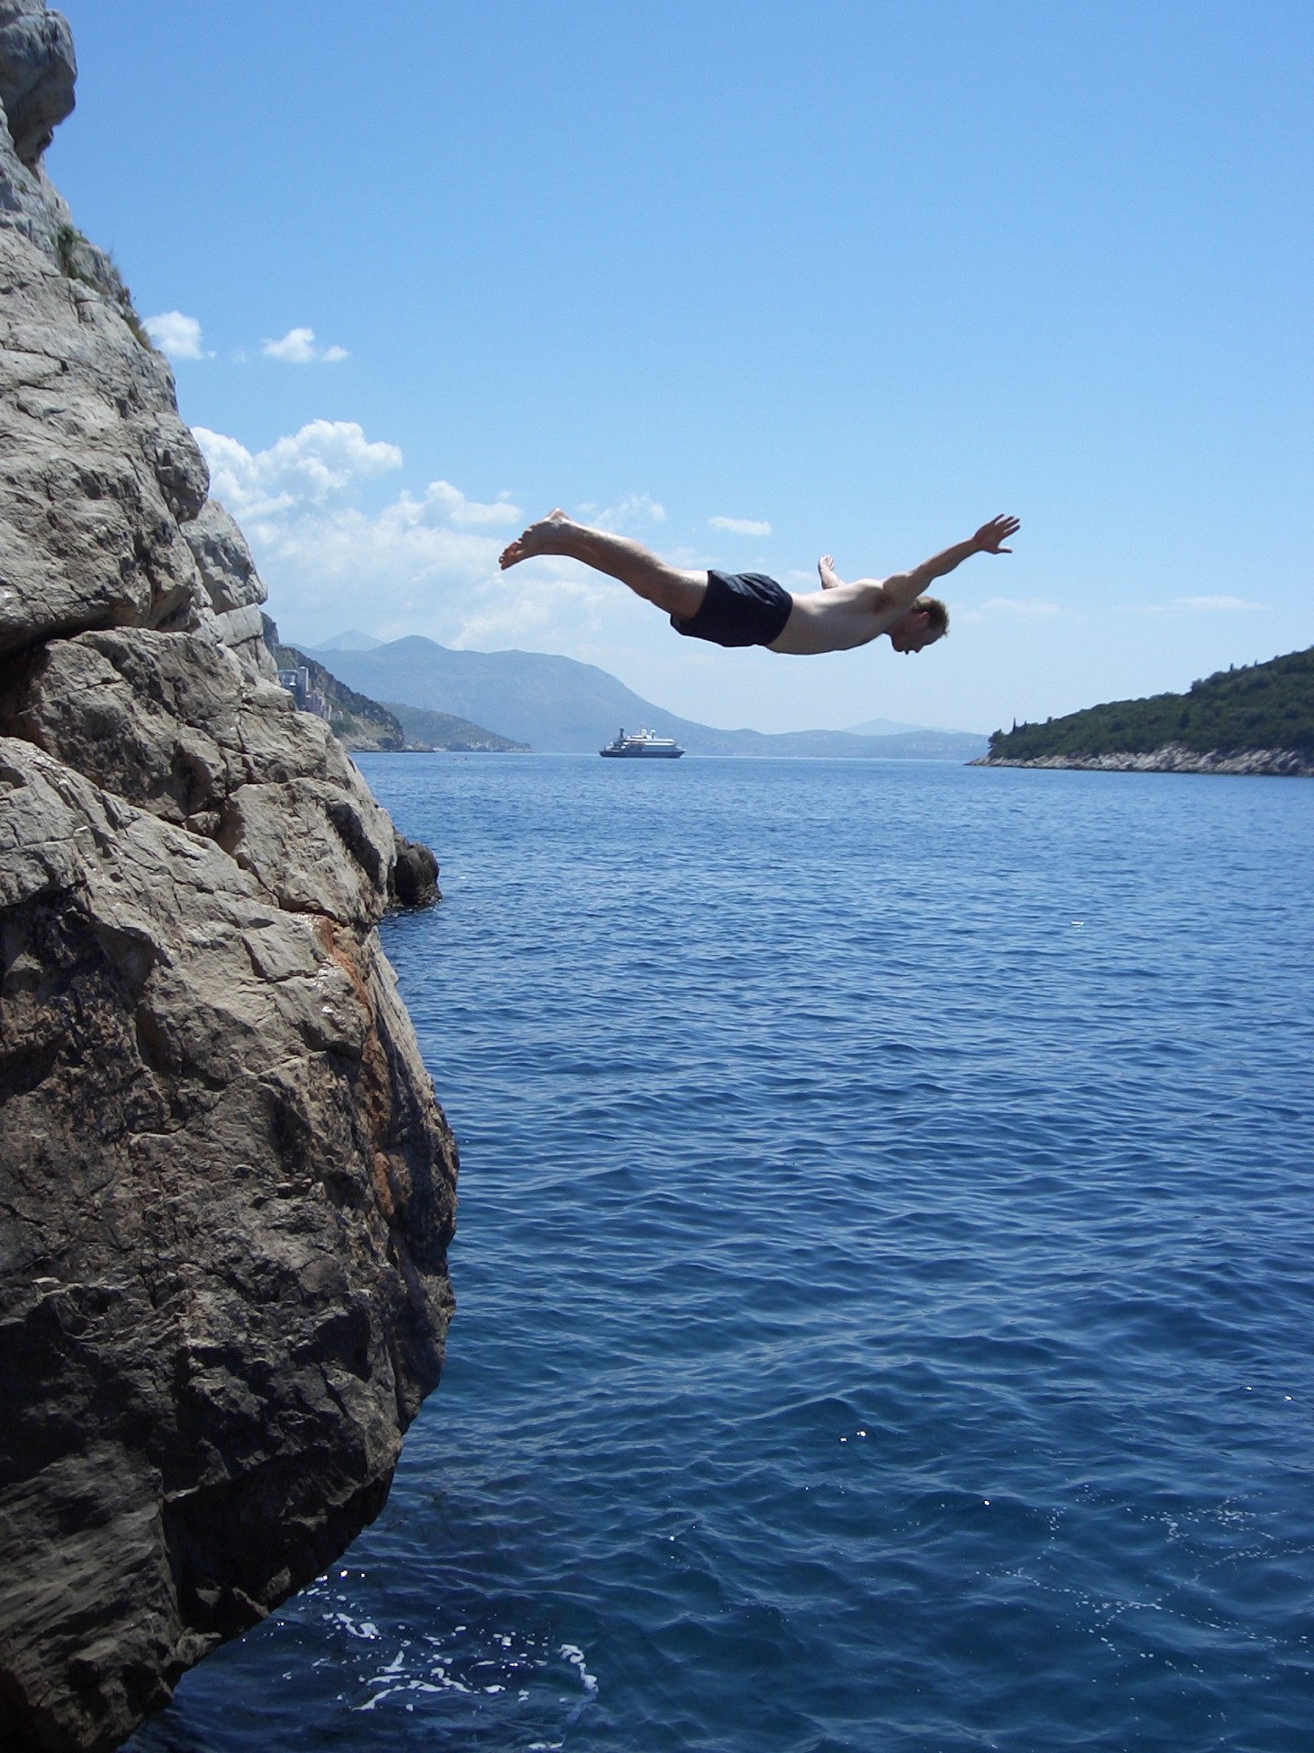
Ready to Dive In?

Slide 131
Hello World
/*
* The canonical hello world program in C++
*/
#include <iostream> // A true classic.
#include "console.h" // A Stanford Library!
using namespace std; // The best namespace.
int main() {
cout << “hello, world!” << endl;
return 0;
}

Slide 132
Hello World
/*
* The canonical hello world program in C++
*/
#include <iostream> // A true classic.
#include "console.h" // A Stanford Library!
using namespace std; // The best namespace.
int main() {
cout << “hello, world!” << endl;
return 0;
}

Slide 133
Hello World
/*
* The canonical hello world program in C++
*/
#include <iostream> // A true classic.
#include "console.h" // A Stanford Library!
using namespace std; // The best namespace.
int main() {
cout << “hello, world!” << endl;
return 0;
}

Slide 134
Hello World
/*
* The canonical hello world program in C++
*/
#include <iostream> // A true classic.
#include "console.h" // A Stanford Library!
using namespace std; // The best namespace.
int main() {
cout << “hello, world!” << endl;
return 0;
}

Slide 135
Logistics
Course Overview
First Program
Excited?

Slide 136
Logistics
Course Overview
First Program
Excited?

Slide 137
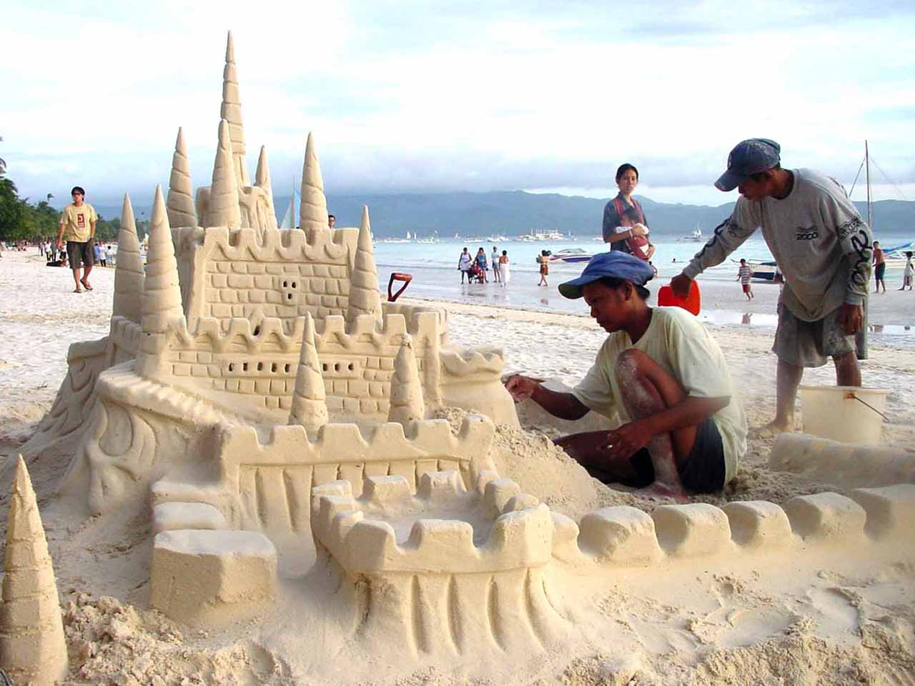
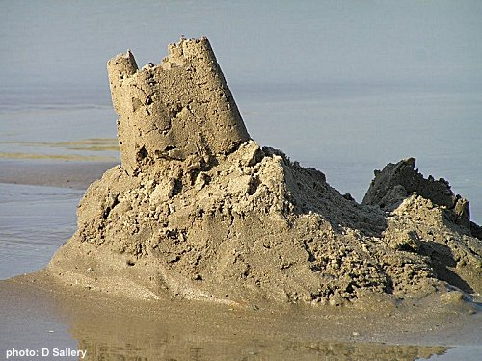
Why CS?

Slide 138

Why CS?

Slide 139
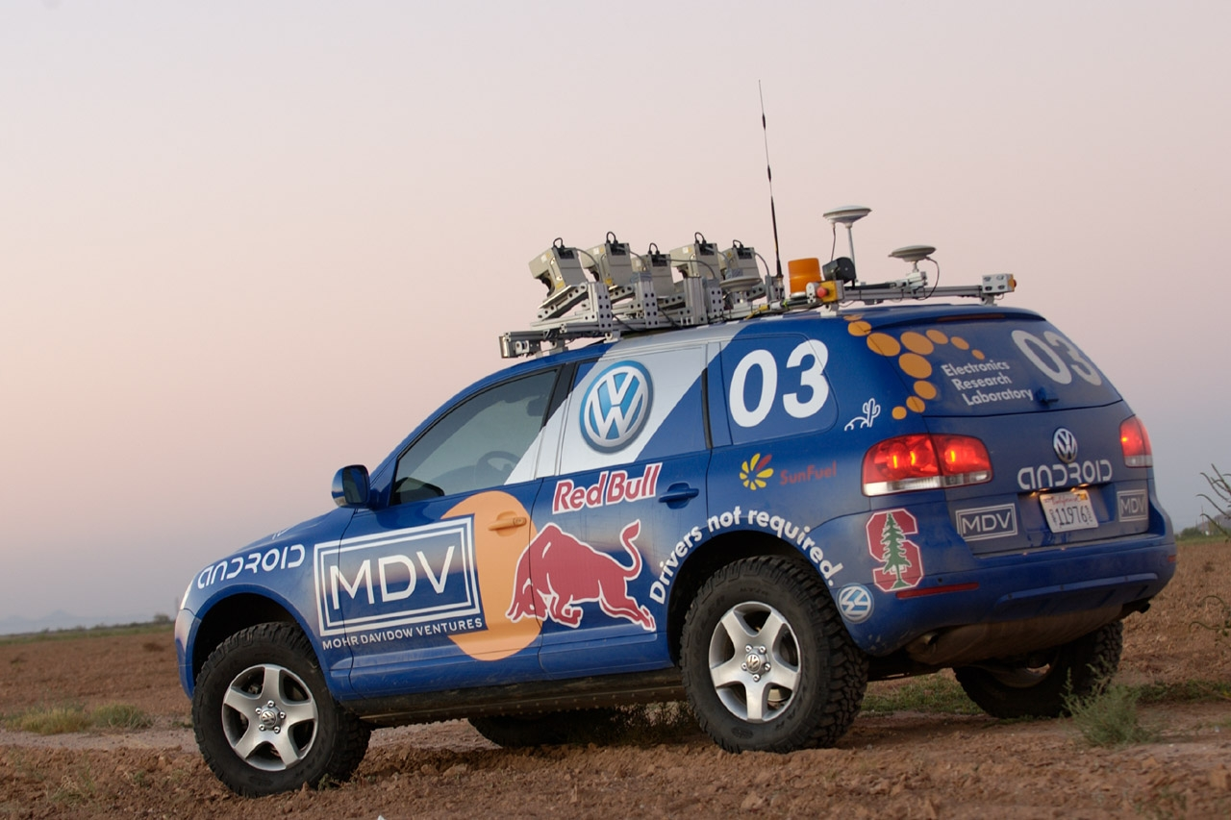
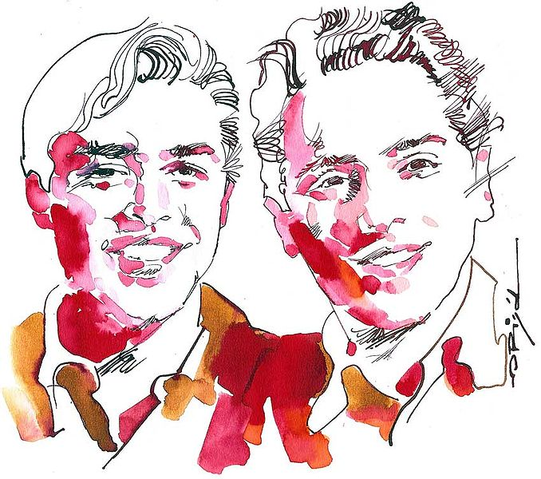
Why CS?

Slide 140
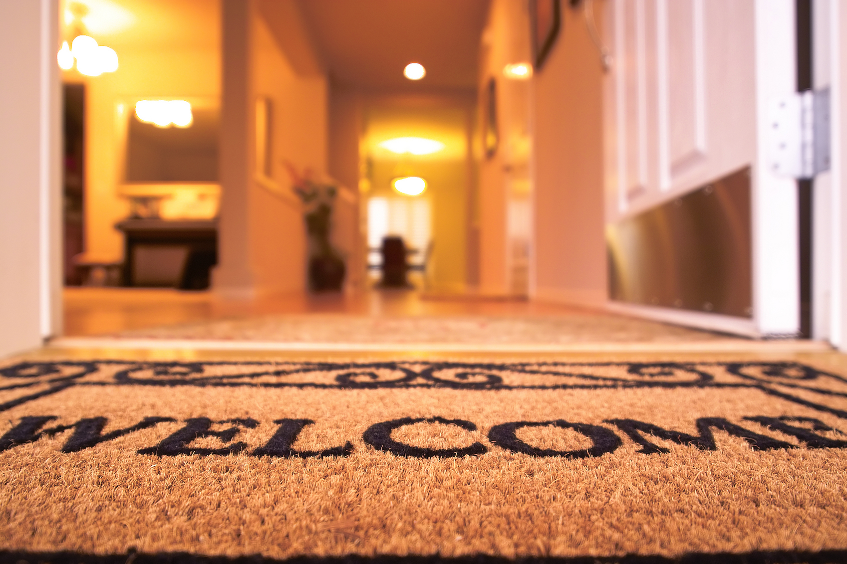
Why CS?

Slide 141
The End.

Slide 142
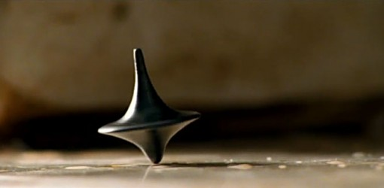
The End?

